Slide 2
WebEx Housekeeping
Stay muted during the entire presentation.
Sign-In using the chat ensuring to select everyone from the drop down menu (name, company name, contact information).
Ask questions at any time during the presentation utilizing the chat. Questions will be addressed at the end of the presentation. Ensure to direct your questions to the entire group by selecting everyone from the drop down. All formal responses to questions will be provided via an Addendum.
Audio only attendees may follow along on the presentation that has been posted to the SAWS solicitation website.

Slide 3
Oral Statements
Oral statements or discussion during the pre-bid meeting today will not be binding, nor will it change or affect the terms or conditions within the Plans and Specifications of this Project. Changes, if any, will be addressed in writing only via an Addendum.

Slide 4
Agenda
General Information
Small, Minority, Women and Veteran-Owned Business (SMWVB Requirements)
IFB Schedule
Contract Solicitation Website
Vendor Registration & Notification (VRN)
Contract Requirements including TWDB
Bid Packet Preparation
Temporary Bid Opening Instructions
Key Reminders
Contact Information
Project Overview
Questions

Slide 5
General Information
This is a Non-mandatory pre-bid meeting
A Geotechnical Data Report is available on the SAWS website upon signing a disclaimer form
Construction services being procured through low bid

Slide 6
Scope of Work
Sealed bids are requested for the following:
construction of a proposed 1.5 MG AWWA D107 Composite Elevated Storage Tank (EST) complete with all piping, valves, handrails, interior and exterior ladders, shell manways, hatches, interior floors and improvements, safety, security, disinfection, and all other tank appurtenances
Electrical equipment, security, SCADA controls and other related appurtenances;
Site improvements, including site preparation, grading improvements, drainage improvements, driveways and other appurtenant work
Approximately 600 L.F. of 20-inch diameter approach water main and 215 L.F. of 8-inch diameter sanitary sewer lateral pipe and connections; *
*will be inserted via Addendum

Slide 7
General Information
 | Dietrich Elevated Storage Tank
Construction Estimate | $6,244,000.00
Contract Duration | 520 Calendar Days

Slide 8
DBE Aspirational Goals
Industry | TWDB DBE Aspirational Goals*
Heavy Civil/Utility Construction | MBE Participation: 19.44% WBE Participation: 9.17% *Updated 8/14/2018.
Notes:
I’d like to briefly go over the SAWS contracting goal categories and their percentages. The goals are aspirational, not mandatory.
First there is the:
PURCHASING TYPE PROCUREMENTS – WHICH HAVE A 19% GOAL
THESE ARE TYPICALLY - LOW BID OR BEST VALUE PURCHASES
Second is the:
CONSTRUCTION CONTRACTS – WITH A 20% GOAL
TYPICALLY – LOW BID CONTRACTS
And Lastly is the:
PROFESSIONAL SERVICE CONTRACTS. THESE ARE DISCRETIONARY CONTRACTS, AND THE GOAL IS
40%.

Slide 9
Required TWDB Forms for DBE Participation
TWDB-0216 (from Prime Consultants/Contractors): Indicates all businesses solicited for procurement, their contact information, and their MBE/WBE status.
TWDB-0217 (from Prime Contractor) certifies that the Prime Contractor understands they must follow the Six Good Faith Efforts and attempt to meet the Fair Share Objectives for MBE/WBE participation.
TWDB-0373 (from Prime Consultants/Contractors) identifies all businesses awarded a subcontract, their contact information, their MBE/WBE status, an actual or anticipated executed contract date, and contract amount. Note: Any businesses operating as brokers may not be listed on the TWDB-0373 as an MBE or WBE.

Slide 10
TWDB-0216

Slide 11
TWDB-0217

Slide 12
TWDB-0373

Slide 13
Accepted Certification
Disadvantaged Business Enterprise (DBE):
An entity owned or controlled by a socially and economically disadvantaged individual as described by Public Law 102-389 (42 U.S.C. §4370d) or an entity owned and controlled by a socially and economically disadvantaged individual as described by Title X of the Clean Air Act Amendments of 1990 (42 U.S.C. §7601 note); a Small Business Enterprise (SBE); a Small Business in a Rural Area (SBRA); or a Labor Surplus Area Firm (LSAF), a Historically Underutilized Business (HUB) Zone Small Business Concern, or a concern under a successor program. This term includes Minority Business Enterprises (MBE) and Women-owned Business Enterprises (WBE).

Slide 14
6 Good Faith Efforts
(1) Ensure DBEs are made aware of contracting opportunities to the fullest extent practicable.
(2) Make information on forthcoming opportunities available to DBEs…in a way that encourages and facilitates participation by DBEs in the competitive process.
(3) Consider in the contracting process whether businesses competing for large contracts could subcontract with DBEs.
(4) Encourage contracting with a consortium of DBEs when a contract is too large for one of these businesses to handle individually.
(5) Use the services and assistance of the Small Business Administration (SBA) and the MBDA of the Department of Commerce.
(6) If the Prime Contractor awards subcontracts, require the prime contractor to take the complete steps (1) through (5) listed above.

Slide 15
Accepted SMWVB Certification Agency
South Central Texas Regional Certification Agency
Any Texas or Federal Source that certifies DBEs
No Local Requirement

Slide 16
Good Faith Effort Plan (GFEP) FAQs
Q: Are the DBE goals mandatory?
A: No, but we ask prime contractors to do their best with good faith outreach efforts. If the goal is not met, proof of outreach efforts is required with the submittal.
Q: What if I am having trouble finding DBE subcontractors?
A: Please email the SMWVB Program Manager with the scopes of work you are seeking. You will receive lists of local SMWVB-certified firms to contact.
Q: What if my business is DBE-certified? Do I need to find DBE subs?
A: If your firm is DBE-certified, you must still perform the 6 outreach efforts prescribed by the TWDB if you will subcontract any part of the job. The GFEP is a required document.
Q: What if I have questions about the GFEP or TWDB Requirements?
A: Please reference the TWDB-0210 Guidance Manual found within the specifications and/or contact the SMWVB Program Manager at 210-233-3420, or at Marisol.Robles@saws.org. DBE/GFEP questions can be asked at any time before the submittal is due.

Slide 17
Post Award: Subcontractor Payment & Utilization Reporting (S.P.U.R.) System
1. Subcontractor & Supplier Payment Tracking
2. Subcontractor and Supplier Additions or Substitutions
3. LCP Tracker
4. Must be Current and Accurate before Retainage is released https://saws.smwbe.com

Slide 18
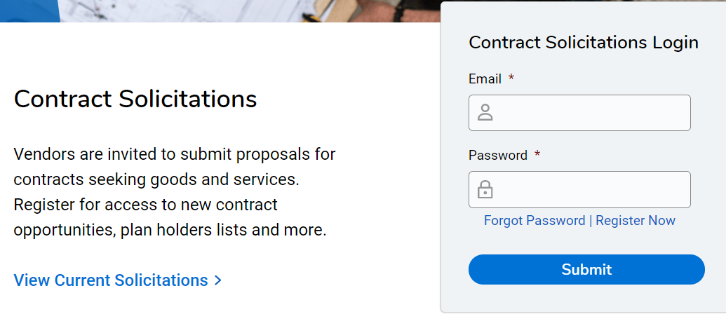
Vendor Registration & Notification (VRN)
Please register through SAWS Vendor Registration Program on the SAWS website at Business Center - San Antonio Water System (saws.org) to ensure access to the latest information.

Slide 19
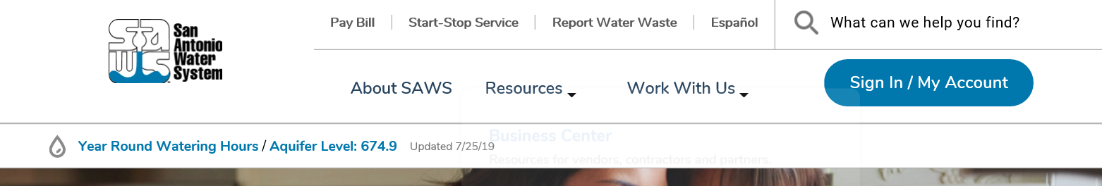
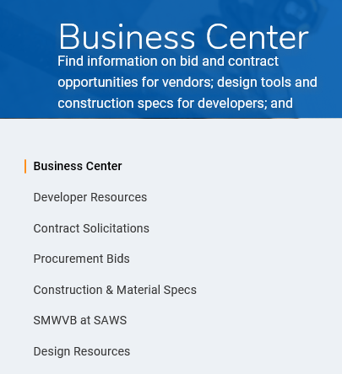
Contract Solicitations Website
To locate the Contract Solicitations website choose Resources
At the drop down menu choose Contract Solicitations

Slide 20
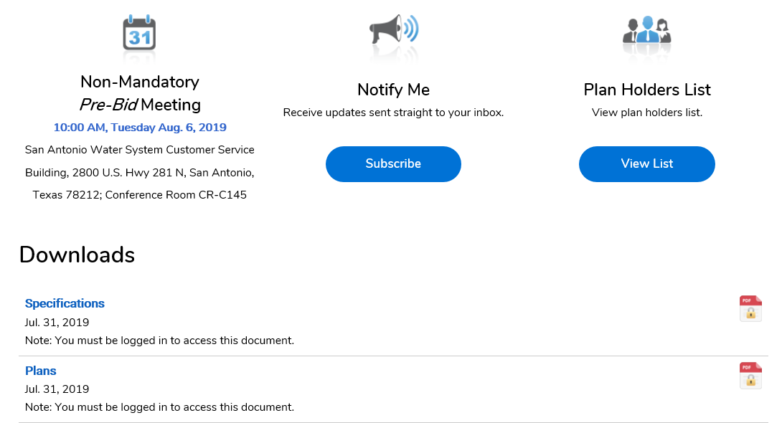
Contract Solicitations Website
Choose the specific project
The following buttons are now located under the advertisement:
  Notify Me
  Plan Holder’s List
  Downloads
    Plans
    Specs
    Addendums
    Geotechnical Data Report

Slide 21
Contract Requirements
Prevailing Wage Rate and Labor Standards – Section 2.10 of the General Conditions
Payroll records are subject to review
Contractors to utilize LCP Tracker
Certified payroll to be submitted on weekly basis
Contractors are responsible for sub-contractor payroll
Late payrolls delay contractor payments from SAWS
Wage decisions are included within the specifications
Site visits by SAWS staff or TWDB are random and unannounced
Interviews will be conducted and will be private & confidential
All apprenticeship programs will need to be approved by Department of Labor prior to starting

Slide 22
Contract Requirements
Supplemental Conditions
Insurance requirements are found in Section 5.7 of the GCs
  Installation Floater in lieu of Builder’s Risk
Will ask for insurance prior to Board award to expedite execution of the contract
  Any deficiencies must be corrected
Compliant prior to executing the contract
  Contractor must maintain insurance coverage during the term of this Project

Slide 23
Contract Requirements
TWDB Project
This project will receive funds from the Texas Water Development Board, which is a low cost loan to SAWS and has no bearing on monthly payments to the Contractor.
TWDB must authorize approval to issue the Notice to Proceed, as well as to Release Retainage.
TWDB Supplemental Conditions – Please review and become familiar with all the TWDB specific requirements within the conditions prior to submitting a bid for this project.

Slide 24
Contract Requirements
TWDB Project
American Iron & Steel Requirements apply to this project.
  Construction materials made of iron or steel must be made in the U.S.A.
  De minimus log form required
  Materials certifications form required (with backup)
  Monthly Compliance Reports required with invoice
  TWDB Inspections (random and unannounced)
Reference the American Iron & Steel Guidance Manual (TWDB-1106) in the specifications, which includes all of the necessary forms.

Slide 25

Contract Requirements
Supplemental Conditions
Contractor shall perform the work with its own organization on at least 40% of the total original contract price which should be indicated on the Good Faith Effort Plan.*
Liquidated damages will be assessed at $700.00 a day for final completion extending beyond contract time.

Slide 26
Bid Packet Preparation
Utilize Bid Packet Checklist within the specifications
Only limited items are required with the initial bid packet
Apparent low bidder must submit additional information within 24 hours of the bid opening to include:
  Conflict of Interest Questionnaire
  Proof of Insurability (Letter from Insurer or Sample Certificate of Insurance)
  Company information packet
  Statement regarding ability to complete the project
  W-9
  Detailed Baseline Schedule using October 1, 2021
  All five (5) Statement of Bidder's Experience (SBE) forms

Slide 27
Bid Packet Preparation (cont.)
Also, within 24 hours, the following will be required since this is a TWDB funded project:
    WRD-255, Bidders Certification Form
    TWDB-0459
    SRF-404
    TWDB-0216
    TWDB-0217
    TWDB-0373
  Also note, that TWDB Forms ED 103 & 104 will be required with signing of the construction contract ahead of Board award

Slide 28
Bid Packet Preparation
Double check all mathematical calculations and verify all extensions
Ensure Mobilization/Demobilization does not exceed percentage
  For Bid Line Items 1-4 only
Addendums are acknowledged on the Bid Proposals
  Check our website regularly for addendum postings
  It is possible to have multiple addendums during the time frame in addition to the scheduled final addendum

Slide 29
Bid Packet Preparation
Statement of Bidder's Experience Form
  Thoroughly complete Statement of Bidder’s Experience form
  All projects should meet the requirements (each check box) identified on the form for each project
  References should be provided by the project Owner
  Contact information should be verified prior to submitting
  A-1 to A-5 performed by Bidder

Slide 30
IFB Schedule
Questions Due
July 26, 2021
4:00pm (CDT)
Answers Posted
July 30, 2021
4:00pm (CDT)
Bids Due
August 6, 2021
2:00pm (CDT)
Lowest Responsible Bidder Notified
August 2021
Board Award September 14, 2021
FTP Request Deadline
August 5, 2021
2:00pm (CDT)

Slide 31
Bid Opening
August 6, 2021 @ 2:00 PM
Bids opening will be held via WebEx, link found on SAWS website
Bids will be received either electronically or hard copy sealed bids
SAWS encourages electronic bids via the secure SAWS FTP site.
  Request to submit the bid electronically through SAWS FTP site must be submitted no later than 2:00pm on August 5, 2021.
Or, Sealed bids will be received by Contract Administration, 2800 U.S. Hwy 281 North, Tower II, Customer Service Building, via a drop box located on the left wall when walking through the first set of double glass doors of the main Tower II entry on the north side of the building.
  If delivering in person to SAWS, Bidders should allow for sufficient travel time
Late bids will NOT be accepted and will be returned unopened.

Slide 32
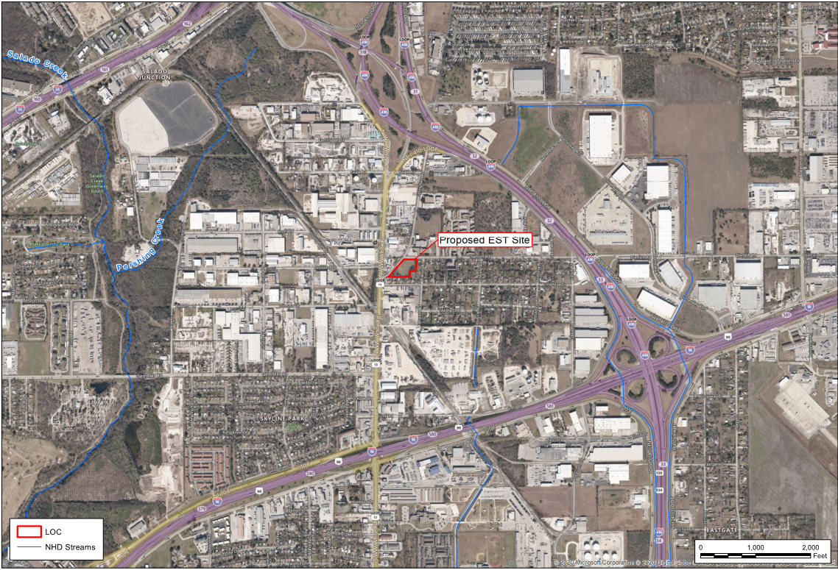
Project Overview
IH-35
410
N Ww White Rd
IH-10

Slide 33
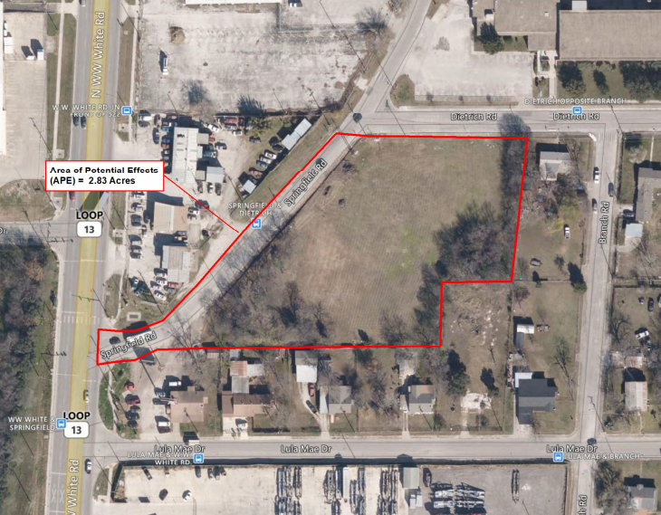
Project Overview
Springfield Rd
N W.W. White Rd
Dietrich Rd

Slide 34
Project Overview
1.5 MG AWWA D107 Composite Elevated Storage Tank
Tank piping and appurtenances
Pressure control valve
24” Yard Piping
Site improvements and grading
Concrete drainage boxes
Drain field
Concrete driveway and sidewalk
Security fencing and property fence replacement
Electrical, instrumentation and security
Site Lighting
Communications and antenna

Slide 35
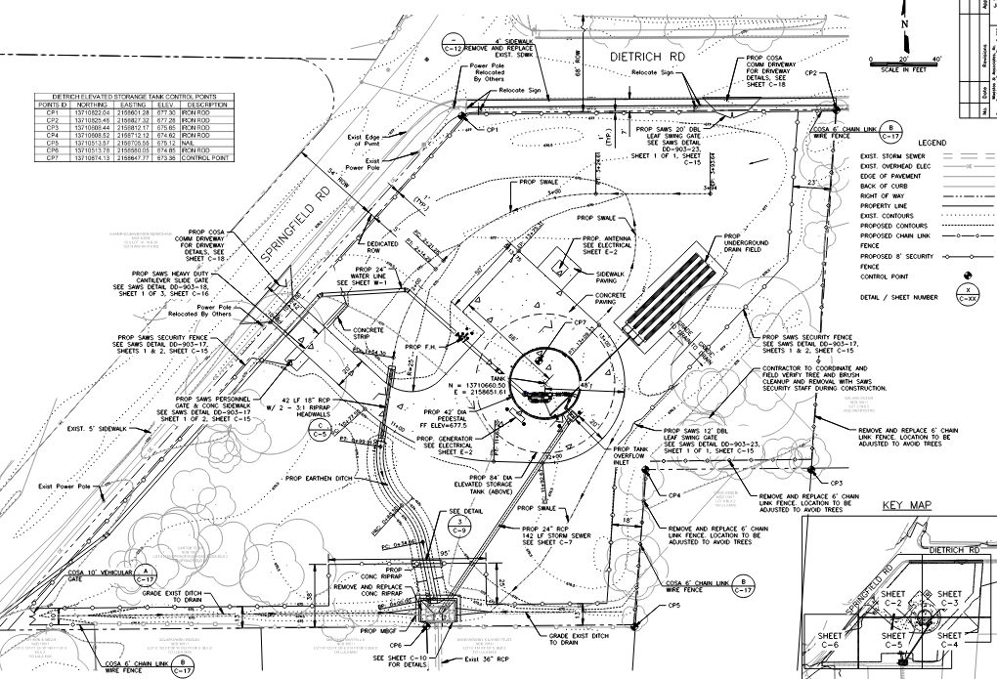
Site Plan

Slide 36
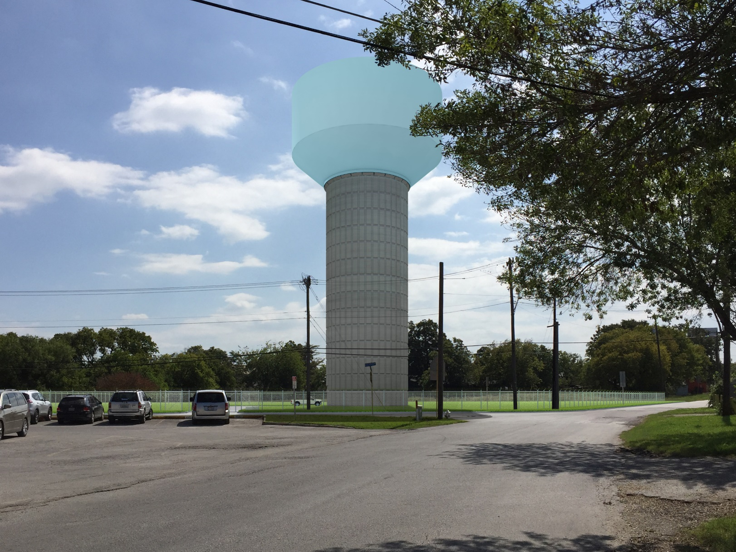
Tank Rendering

Slide 37
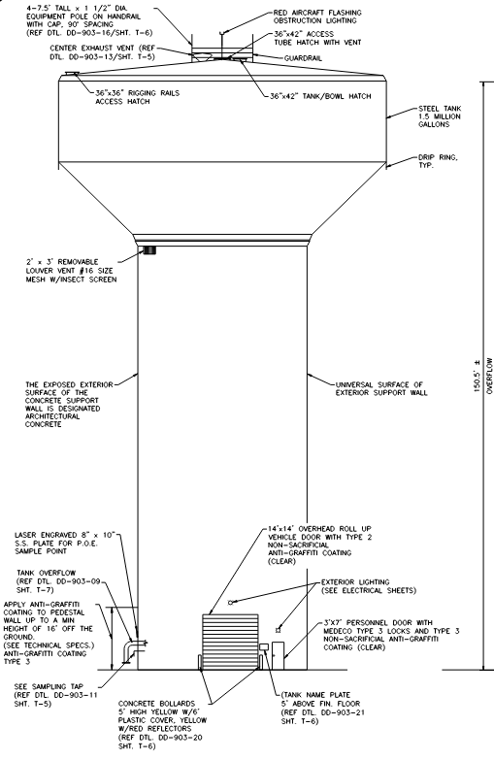
EST Details
Height will be approximately 150.5 feet tall with an overflow weir elevation of 828 feet
Tank diameter may range from 80 to 90 feet with a pedestal diameter of 42 feet.

Slide 38
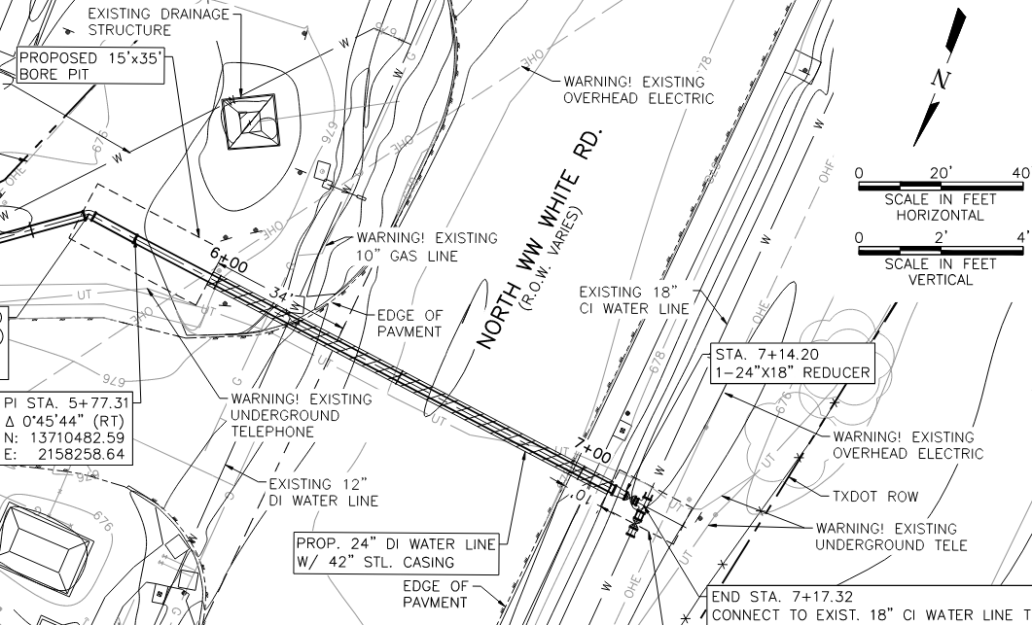
Water Line Details
The approach main water line will be a 24-inch diameter pipe and connect the EST to the PZ 828 system along N. WW White Road.
Approximately 620 linear feet.
Bore underneath N. WW White Road and connection to existing 18” water line.

Slide 39
Key Reminders
All questions should be sent in writing by the Q & A due date to the corresponding Contract Administrator by email Lindsay.Esquivel@saws.org or fax, 210-233-4236.
Please identify the project by its associated solicitation number. (CO-00274-LE)

Slide 40
Contact Information
Contact Name | Title | Telephone Number | Email address
Lindsay Esquivel | Contract Administrator | 210-233-2443 | Lindsay.Esquivel@saws.org
Marisol Robles | SMWVB Program Manager | 210-233-3420 | Marisol.Robles@saws.org
REMINDER
Please be advised that Bidders are prohibited from communicating with any other SAWS staff, the Consultant, or City of San Antonio officials regarding this Invitation to Bidders up until the contract is awarded as outlined in the Instructions to Bidders.

Slide 41

QUESTIONS
Reminder: Oral statements or discussion during the pre-bid meeting today will not be binding, nor will it change or affect the terms or conditions within the Plans and Specifications of this Project. Changes, if any, will be addressed in writing only via an Addendum.

